Slide 1
3. Unit 3
This unit contains following topics:
Linked list ADT’s (linear, double and circular)
Stacks (using static and dynamic lists)
Application of stacks
Queue ( linear and circular)
Data Structure BY S.R. Sharma

Slide 2
ADT’s
An abstracts data type commonly called as ADT. It is the set of operation which is used with the component of the element of that abstract data type. We can simply take the abstract data of a list consists of the following operation.
Insertion
Deletion
Search
Display
Data Structure BY S.R. Sharma

Slide 3
Cont..
So the data structures with the specific operations are called abstract data type. There are 4 levels in which we refine the problems then ADTs increase the efficiency of a programming and execution of program.
1. All the abstract level will recognize the relationship among the data elements and access in functions. But we do not decide anything how the data will actually store and the operation performed.
2. On the data structure level we recognize more details so that we can analyses the behavior of the operation and make appropriate choice for requirement.
Data Structure BY S.R. Sharma

Slide 4
Cont..
3. At the implementation level we decide the ways to represents the data in computer memory. To implements the operation in programming language.
4. On the application level final details of the particular operation are decided.
Data Structure BY S.R. Sharma

Slide 5
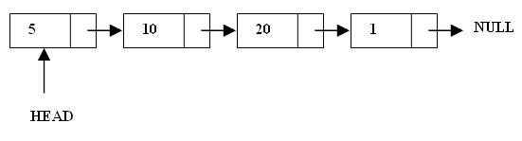
What are Linked Lists
A linked list is a linear data structure.
Nodes make up linked lists.
Nodes are structures made up of data and a pointer to another node.
Usually the pointer is called next.

Slide 6
Arrays Vs Linked Lists
Arrays | Linked list
Fixed size: Resizing is expensive | Dynamic size
Insertions and Deletions are inefficient: Elements are usually shifted | Insertions and Deletions are efficient: No shifting
Random access i.e., efficient indexing | No random access → Not suitable for operations requiring accessing elements by index such as sorting
No memory waste if the array is full or almost full; otherwise may result in much memory waste. | Since memory is allocated dynamically(acc. to our need) there is no waste of memory.
Sequential access is faster [Reason: Elements in contiguous memory locations] | Sequential access is slow [Reason: Elements not in contiguous memory locations]

Slide 7
Types of lists
There are two basic types of linked list
Singly Linked list
Doubly linked list

Slide 8
Singly Linked List
Each node has only one link part
Each link part contains the address of the next node in the list
Link part of the last node contains NULL value which signifies the end of the node

Slide 9
Schematic representation
Here is a singly-linked list (SLL):
start
a
b
c
d
Each node contains a value(data) and a pointer to the next node in the list
start is the header pointer which points at the first node in the list

Slide 10
Basic Operations on a list
Creating a List
Inserting an element in a list
Deleting an element from a list
Searching a list
Reversing a list

Slide 11
Creating a List
Strecture definition struct node { int info; struct node *link; }*start; | create_list(int data) { struct node *q,*tmp; tmp= malloc(sizeof(struct node)); tmp->info=data; tmp->link=NULL; if(start==NULL) /*If list is empty */ start=tmp; else { /*Element inserted at the end */ q=start; while(q->link!=NULL) q=q->link; q->link=tmp; } }/*End of create_list()*/
info
link
Data Structure BY S.R. Sharma

Slide 12
Inserting an element in a list
There are 3 cases here:-
Insertion at the beginning
Insertion at the end
Insertion after a particular node
Data Structure BY S.R. Sharma

Slide 13
Insertion at the beginning
There are two steps to be followed:-
Make the next pointer of the node point towards the first node of the list
Make the start pointer point towards this new node
If the list is empty simply make the start pointer point towards the new node;
Data Structure BY S.R. Sharma

Slide 14
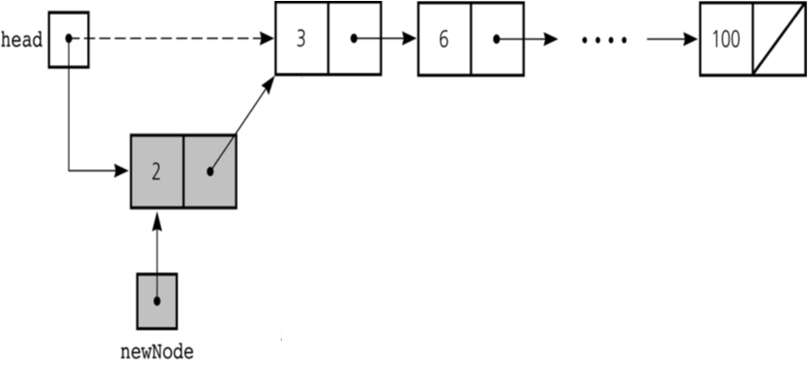

Slide 15
Cont..
addatbeg(int data) { struct node *tmp; tmp=malloc(sizeof(struct node)); tmp->info=data; tmp->link=start; start=tmp; }/*End of addatbeg()*/
Data Structure BY S.R. Sharma

Slide 16
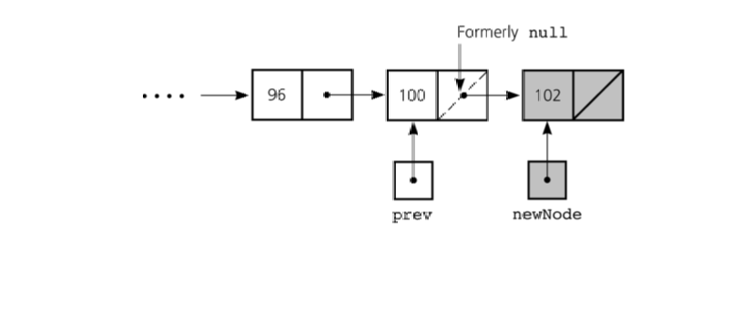
Inserting at the end
Here we simply need to make the next pointer
of the last node point to the new node

Slide 17
Inserting after an element
Here we again need to do 2 steps :-
Make the next pointer of the node to be inserted point to the next node of the node after which you want to insert the node
Make the next pointer of the node after which the node is to be inserted, point to the node to be inserted

Slide 18
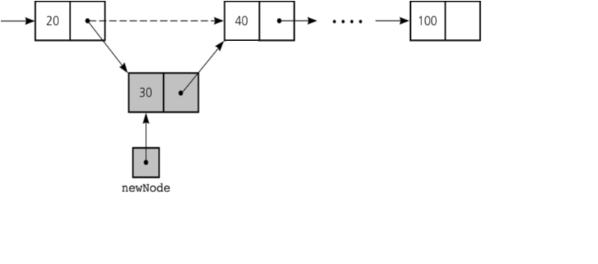

Slide 19
addafter(int data,int pos) { struct node *tmp,*q; int i; q=start; for(i=0;i<pos-1;i++) { q=q->link; if(q==NULL) { printf("There are less than %d elements",pos); return; } }/*End of for*/ | tmp=malloc(sizeof(struct node) ); tmp->link=q->link; tmp->info=data; q->link=tmp; }/*End of addafter()*/
Data Structure BY S.R. Sharma

Slide 20
Deleting from a linked list
For deleting the node from a linked list, first we traverse the linked list. After finding the elements there may be two cases for deleting
Deleting at beginning
Deleting in between or at last.
Data Structure BY S.R. Sharma

Slide 21
Deleting at beginning
Here start points to the first elements of linked list. If elements to be deleted is the first elements of linked list then we assign the value of start to temp as
temp=start:
so now tmp points to the first node which has to be deleted
Now we assign the link part of the deleted node to start as
Start=start->link:
since start points to the first elements of linked list, so
Start->link will point to the second elements of linked list.
Data Structure BY S.R. Sharma

Slide 22
Cont..
Now we should free the elements to be deleted which is pints by tmp.
free(tmp);
the whole process for deleting of first elements of linked list will be-
tmp=start;
start=start->link;
free(tmp);
Data Structure BY S.R. Sharma

Slide 23
Deleting in between or at last.
If the elements is other than the first elements of linked list then we give the link part of the deleted node to the link part of the previous node. This can be as-
tmp=q->link;
q->link=tmp->link;
free(tmp);
here q is pointing to the previous node of node to be deleted. After statement 1 tmp will point to the node to be deleted. After statement 2 link of previous node will point to next node of the node to be deleted. If node to be deleted is last node of linked list then statements 2 will be as
q->link =NULL;
Data Structure BY S.R. Sharma

Slide 24
del(int data) { struct node *tmp,*q; if(start->info == data) { tmp=start; start=start->link; /*First element deleted*/ free(tmp); return; } q=start; while(q->link->link != NULL) { if(q->link->info==data) /*Element deleted in between*/ { tmp=q->link; | q->link=tmp->link; free(tmp); return; } q=q->link; }/*End of while */ if(q->link->info==data) /*Last element deleted*/ { tmp=q->link; free(tmp); q->link=NULL; return; } printf("Element %d not found\n",data); }/*End of del()*/
Data Structure BY S.R. Sharma

Slide 25
Traversing a linked list
In linked list, info is the information part, link is the address part of next node. We take ptr as a pointer variable. Here start is a pointer that points to the first elements of the list.
Initially we assign the value of start to prt. We can point to the first elements of list. For processing to the next elements
We assign the address of next elements to the ptr as
prt=prt->link;
We can travers each elements of linked list through this assignments until prt has NULL address which is link part value of last elements.
Data Structure BY S.R. Sharma

Slide 26
Cont..
So the linked list can be traversed as
while(prt!=NULL)
prt=prt->link;
display() { struct node *q; if(start == NULL) { printf("List is empty\n"); return; } q=start; | printf("List is :\n"); while(q!=NULL) { printf("%d ", q->info); q=q->link; } printf("\n"); }/*End of display() */
Data Structure BY S.R. Sharma

Slide 27
THANK YOU
Data Structure BY S.R. Sharma

